Slide 1





RAKSHITHA 1DS12CS074
RISHABH 1DS12CS076
RUMANI 1DS12CS078

Slide 2

INTRODUCTION TO MULTITOUCH
Technology is touching more people’s lives every day.
Multi-touch enabled devices have a profound impact in industrial settings.
Nearly everyone - end users, panel operators, engineers, managers, purchasers, executives interact frequently with this Technology.
Multi touch technology can make workers more productive and facilities more
profitable, because users can simply do so many things with just their fingers.

Slide 3
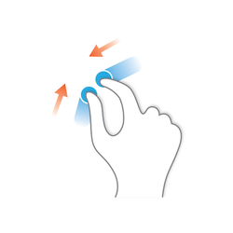
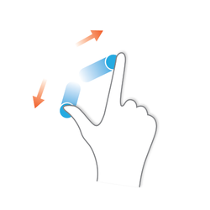
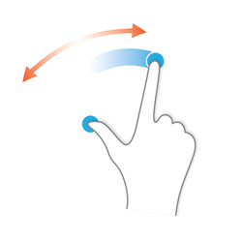
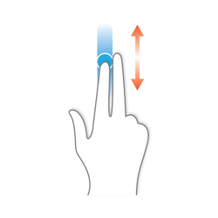
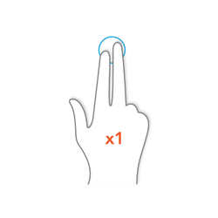
Multi-touch gestures
Pinch close
Pinch open
Rotate
Two Finger Tap
Two Finger Scroll

Slide 4
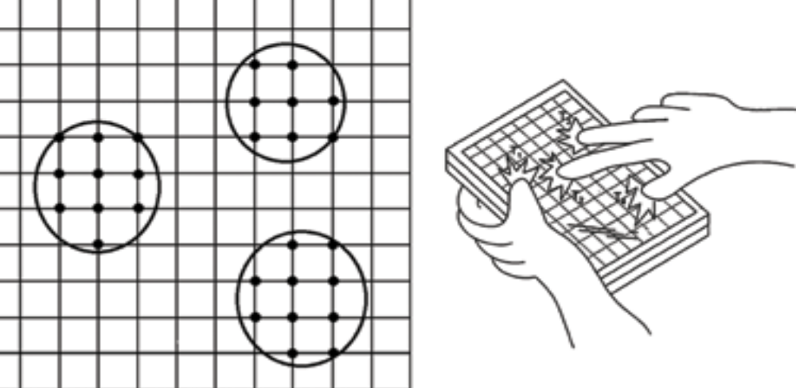
What Is Multi Touch?
Single Touch Users can select a single point, drag and drop, push and slide with only a single Finger or stylus | Multi Touch Enable devices to recognize and respond to touch inputs at multiple locations simultaneously.
Figure1 shows what happens in a multi touch monitor.
The screen utilizes a grid for locating the inputs at multiple locations.
The device senses whole groupings rather than just one point of intersection.
This yields high accuracy.
FIG 1: MULTI TOUCH
Department of Computer Science & Engineering, DSCE

Slide 5
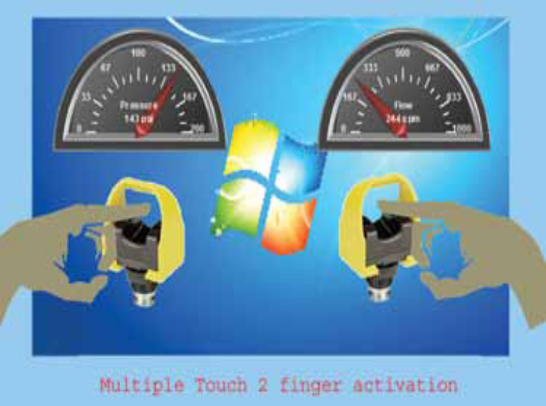
Unique gestures on the touch screen display serve as the new password while the meeting schedule further secures the entry.
Another example is building automation: imagine your building is big enough that when the floor plan fills a display, details are rendered too small to see. At this level, all you can do is get an overview, which is enough for new visitors trying to find their way around but proves insufficient for other needs.
Consider a user who wants to find an electrical outlet for his or her iPhone: the user must zoom in and out repeatedly in order to examine each likely location.
FIG 2
Multi touch gestures greatly simplify an otherwise manual zooming process. The display may contain important indicator information, like temperature, moisture, safety indicators, pressure volume, etc. all this information at the user’s fingertips.
Similarly, if a user needed to read a manual, multi touch makes two-finger scrolling, pinching, spreading and rotating all available and with no learning curve.

Slide 6
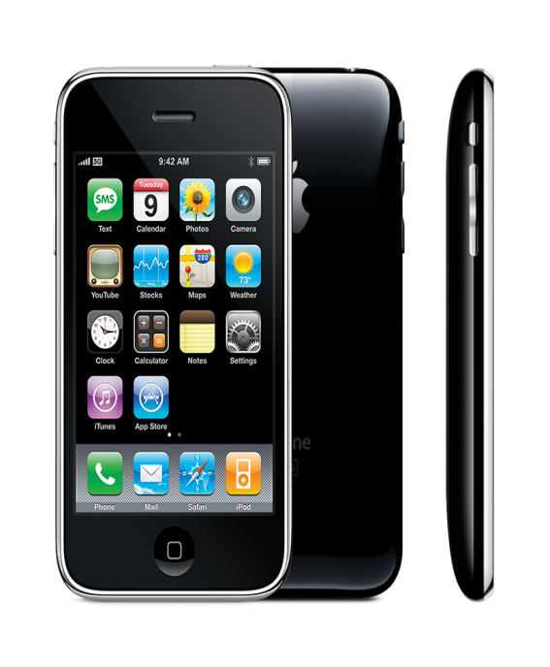
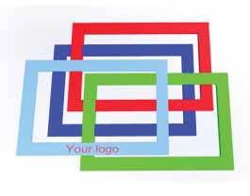

The Leaders…
2007 - The Apple iPhone
Leaping forward, the first Apple iPhonexiv was released on June 29, 2007.
Its touch screen Liquid crystal display with scratch-resistant glass was a notable advance: the first introduction to a large market of the projected capacitance technology, designed for a bare finger or fingers.
A proximity sensor would deactivate the display and touch screen whenever the device was brought near the face during a call; this feature would save battery power while also preventing inadvertent inputs from the user’s face and ears.
The touch and gesture features of the iPhone are based on technology originally developed by Finger Works.
2013 - AIS
AIS is embracing this technology with off the shelf and custom made-to-order product solutions, including the newly developed ability to imprint color logos and text on glass displays.

Slide 7
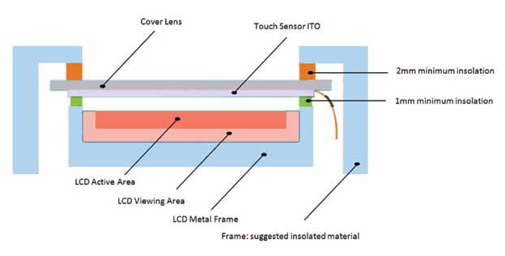
Touch display layers
Touchscreen Construction
A capacitive touch screen sensor
consists of indium tin oxide (ITO)
conductors on many layers of glass.
ITO has good optical clarity and
low resistivity making it the perfect
choice for this sensitive circuit.
In between the display screen
and the touch sensor , there’s an
insulating material to avoid
interference from capacitive noise.
Touch Input Technologies
Many devices use SAW (Surface Acoustic Wave), Capacitive touch input ,infrared & analog resistive technologies.

Slide 8
Coordinates Of Touch
The location of touch once determined is sent to the controller for processing. A fairly straightforward description by Apple is:
Read output from sensing points, producing and analyzing the touch data.
Compare the current data to past data and perform actions based on it.
Receive and filter the raw data, generate gradient data, calculate boundaries and coordinates for each touch region, performing multipoint tracking.

Slide 9
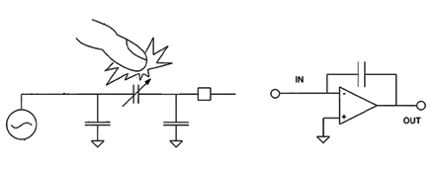
Capacitive Touch Technology
A capacitive touch screen panel consists of glass, coated with a transparent conductor, like ITO (indium tin oxide).
The user’s finger conducts electricity, so touching the screen surface results in a distortion of the screen’s electrostatic field; measurable as a change in capacitance.
A capacitance-based sensor circuit is designed to sense touch by coupling with the electrical fields; touch causes the capacitance of the circuit to change.
Input power, capacitive sensing and signal amplification

Slide 10
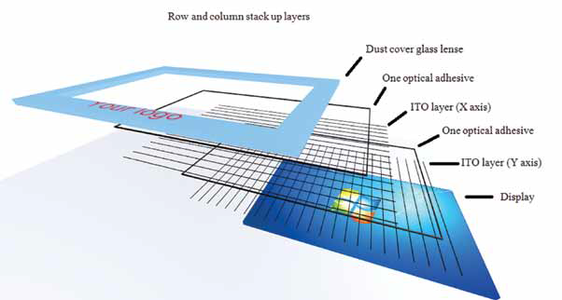
Advantages over others…
Unlike a resistive touch screen, capacitive touch displays require the direct contact with the finger or a capacitive stylus. However, despite this limitation, the benefits of capacitance-based sensors are numerous, including a long lifetime as there is no physical contact with the actual sensors. A projected capacitive circuit sensor is sensitive enough to sense through glass up to 6mm thick.
Dust cover glass lenses. 6mm thick with vandal proof glass.

Slide 11
CONCLUSION
We’ve now explored how multi touch technologies open up a world of possibilities.
Users can simply do so many things with their fingers that were impossible before.
Particularly in complex industrial environments, touch input applications can expand functionality and streamline operations with little-to-no learning curve for operators.
We also examined the underlying electronics and science, to empower readers to understand and discuss multi touch software and devices with colleagues and vendors.
It not only saves expert animators time in creating key-frames, but allows both expert and novice to perform real-time animation for communicating temporal concepts.
It shows that multi-touch interaction is useful not just for human-computer communication, but for human-human communication as well.

Slide 12
LIMITATIONS
In particular, the adjustable area cursor may lead to increased cognitive overhead in cluttered areas, which may lead to poor performance.
Another issue is the usability of the three state touchpad for precise manipulation tasks.
The touchpad switch is activated by the same muscle groups that control the cursor.
The added tension to the fingers may reduce precision, or lead to other types of interference.

Slide 13
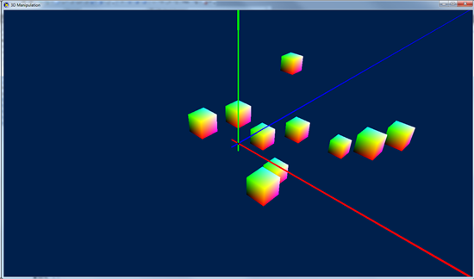
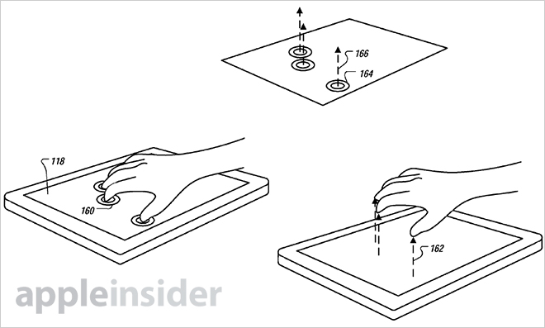
APPLICATIONS
3D MANIPULATIONS

Slide 14
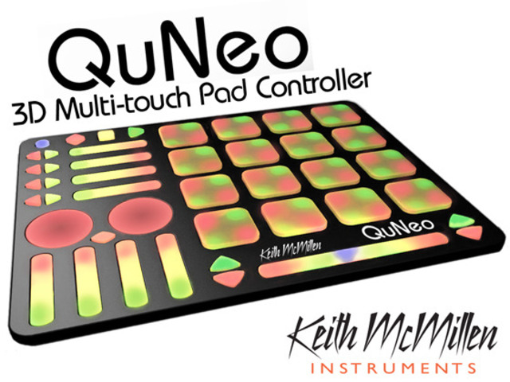
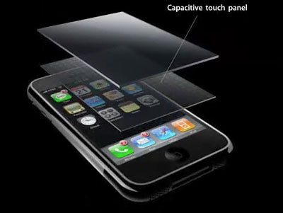
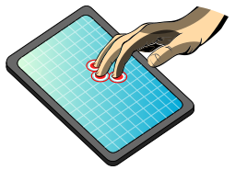
MULTITOUCH INSTRUMENTS
Department of Computer Science & Engineering, DSCE

